Slide 1
BABA FARID COLLEGE
MUKTSAR ROAD, DEON, BATHINDA (Punjab) India – 151 001
DEPARTMENT OF PHYSICS
RESULT CEREMONY ON
BEST OUT OF WASTE
ACTIVITY
HELD ON
18TH MAY, 2020

Slide 2
RESPECTED JURIES
Ms. Navninder Dhillon, Dean Academic Affairs, BFGI
Dr. Amandeep Hrar, DAA BFC

Slide 3
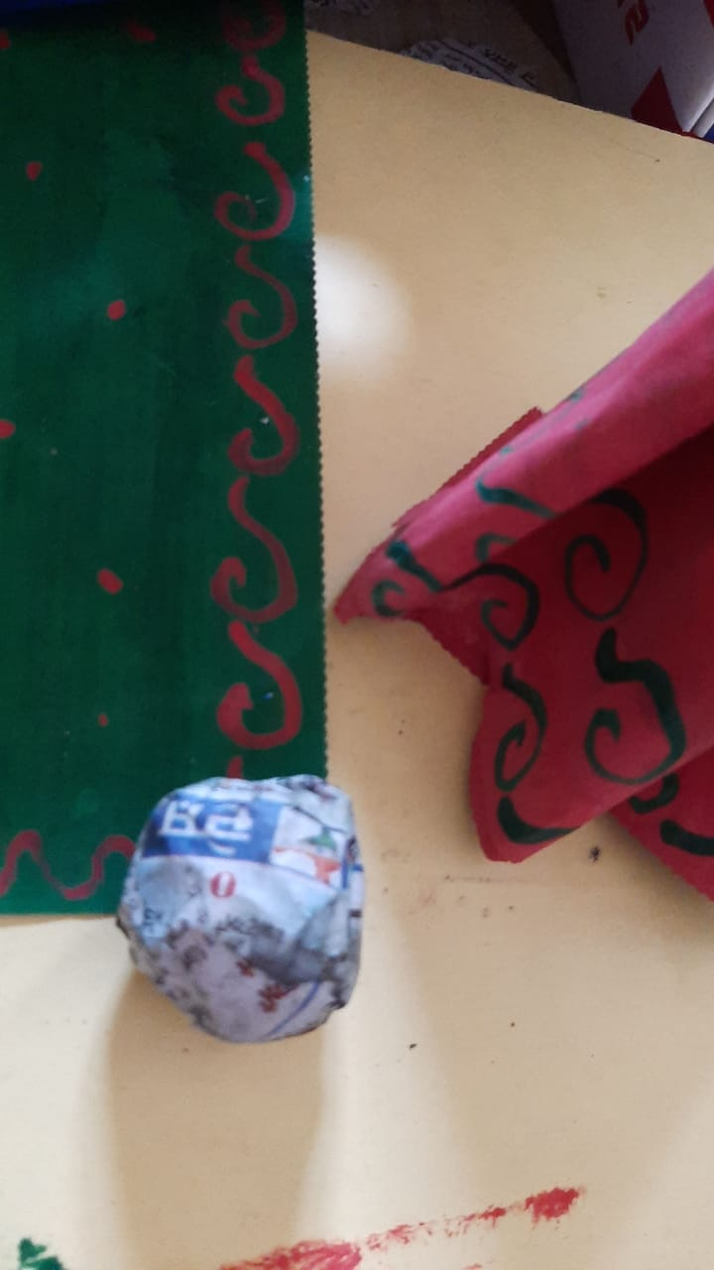
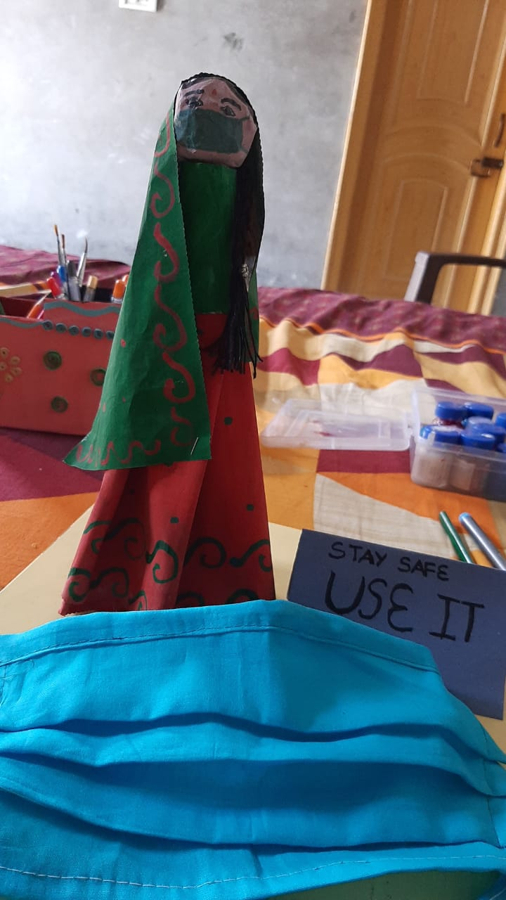
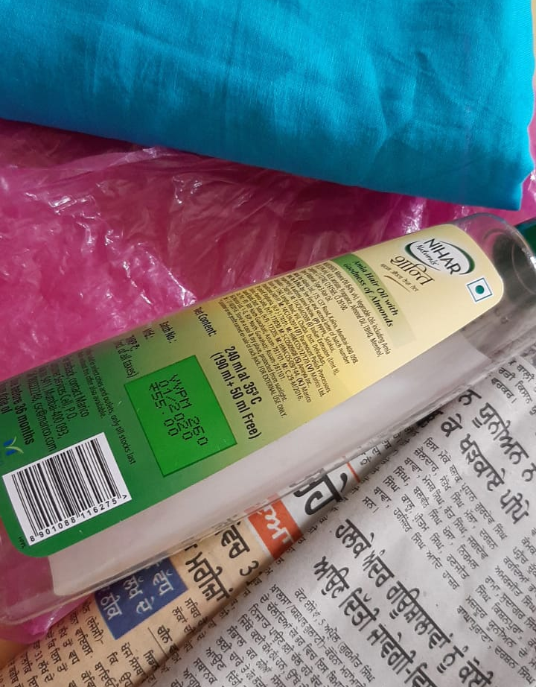
Model of woman wearing mask with a mask for motivation to use mask and stay safe.
APARAPPAR KAUR

Slide 4
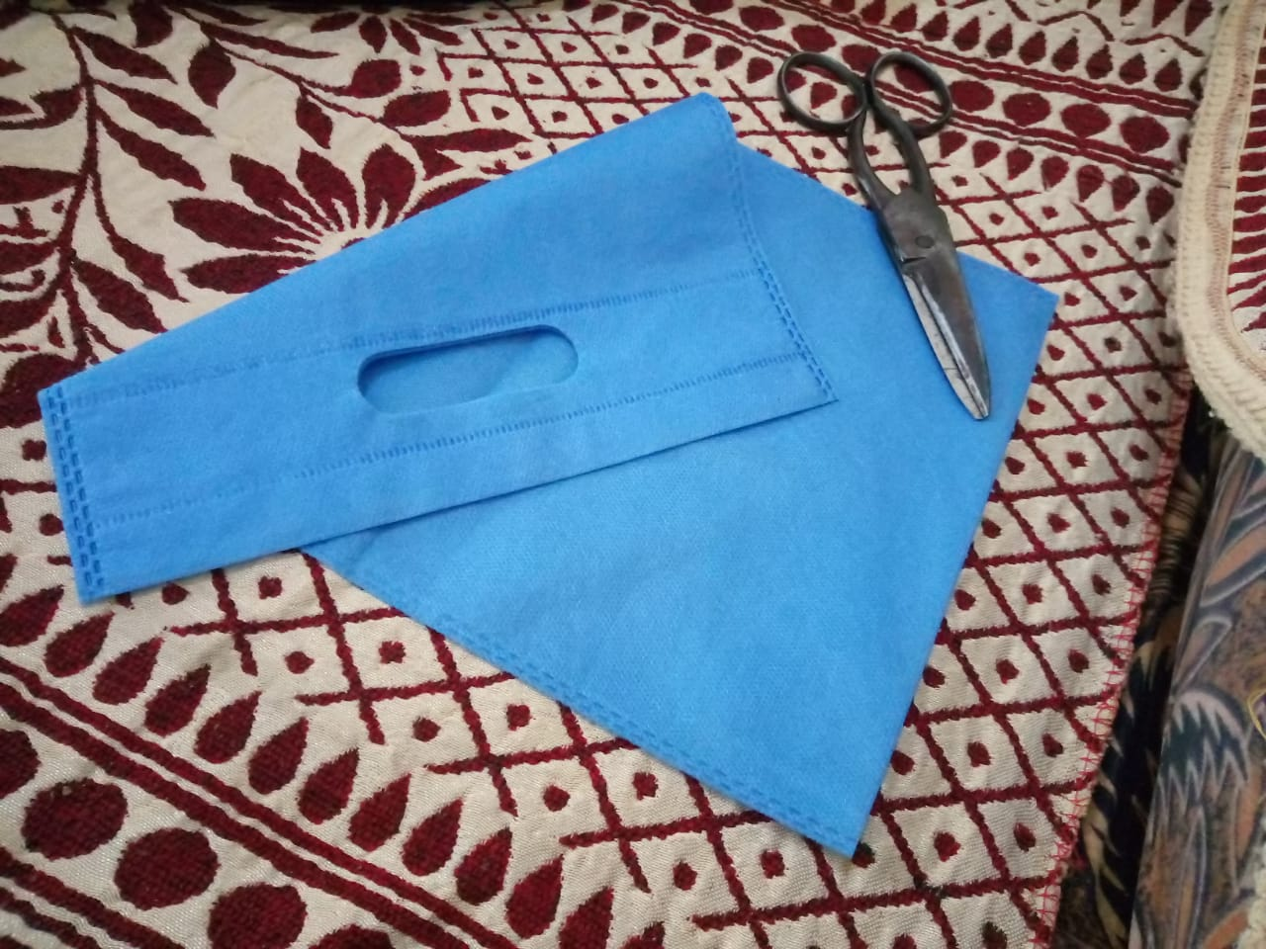
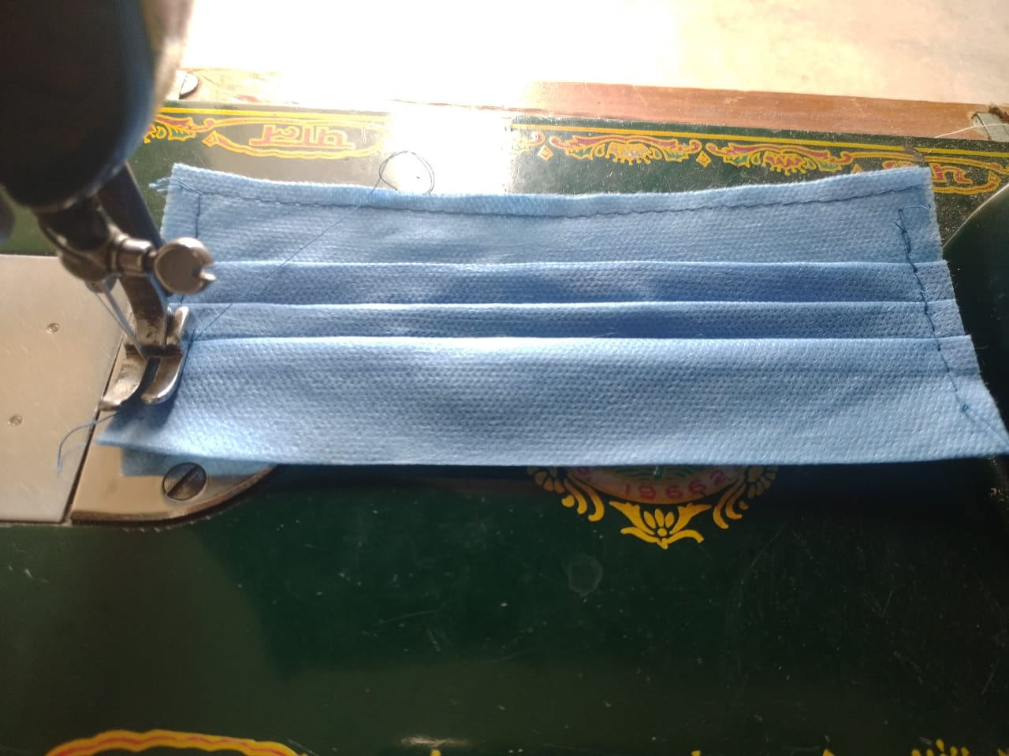
Fir Muskurayega India.
TEENA

Slide 5
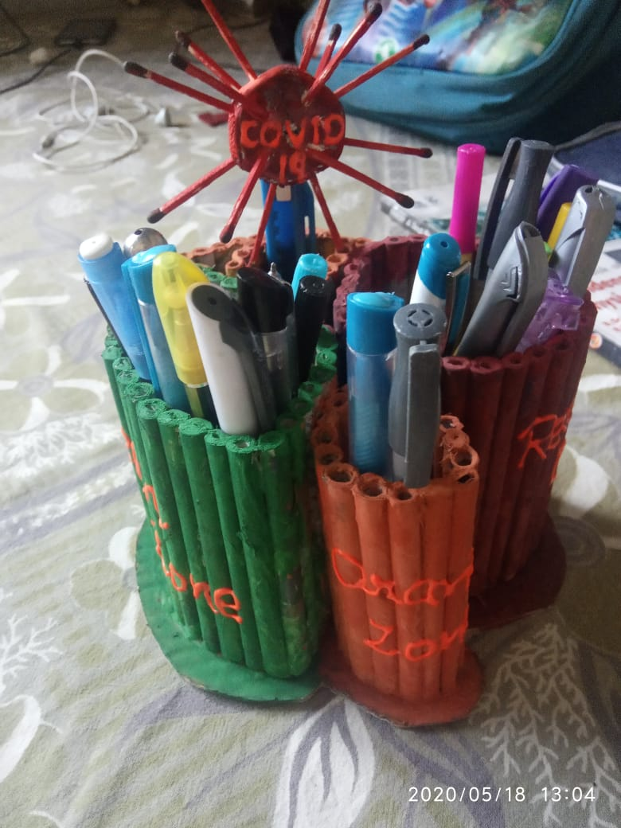
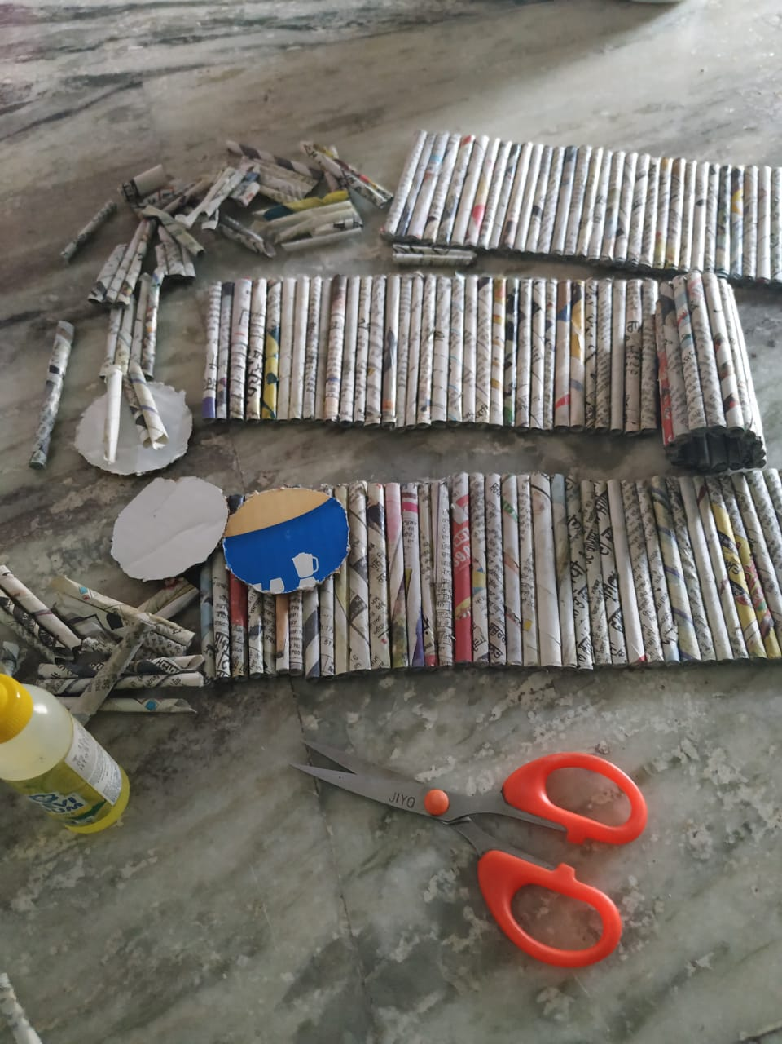
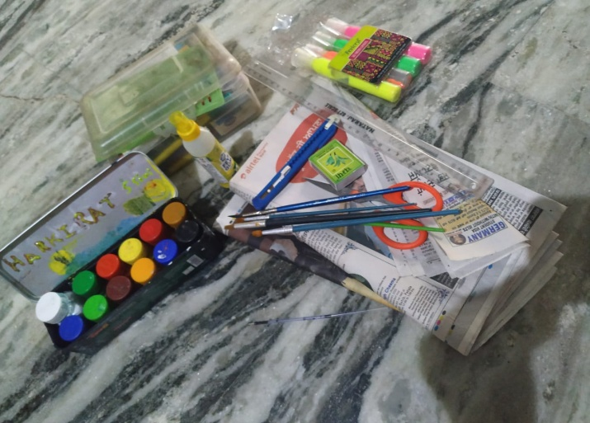
Pen holder
VEERPAL KAUR

Slide 6
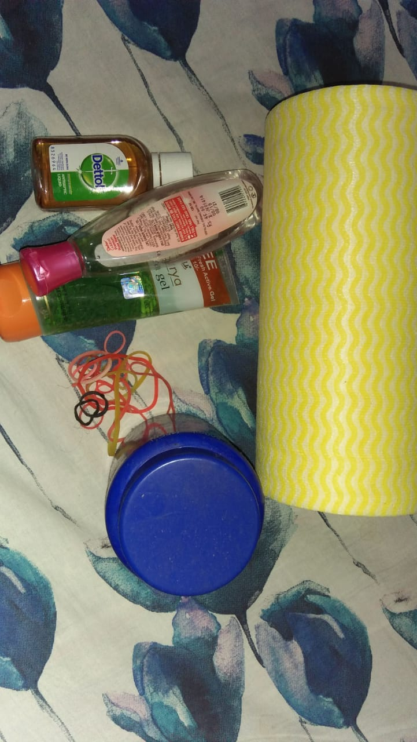
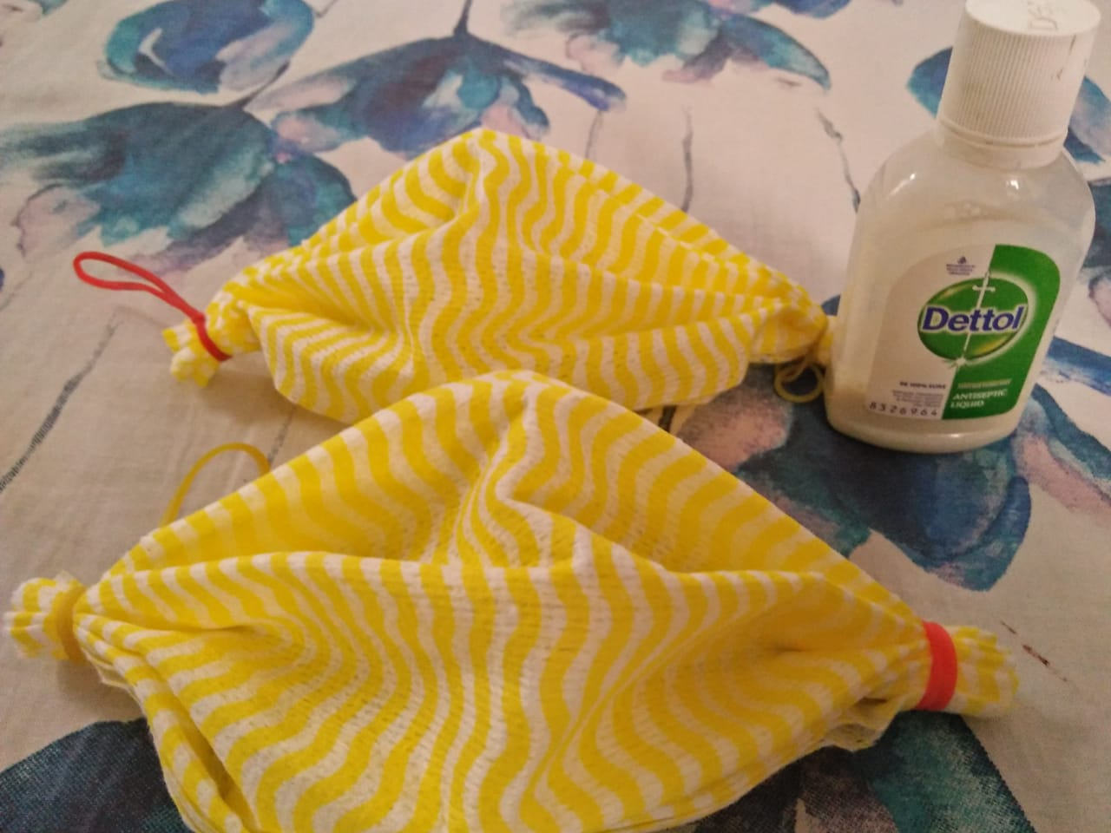
Home made sanitizer and masks ...as we know very well ....we can use one mask in one time after that we can wash or put it in dustbin ...thats why I made that mask. which is easy to made ....in sanitizer we can use only 3things ..
VISHALI

Slide 7
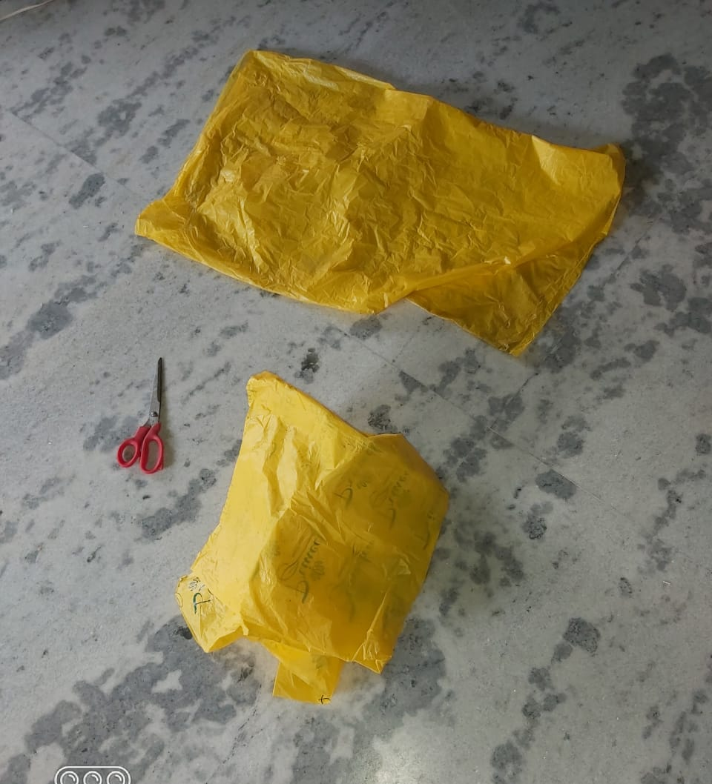
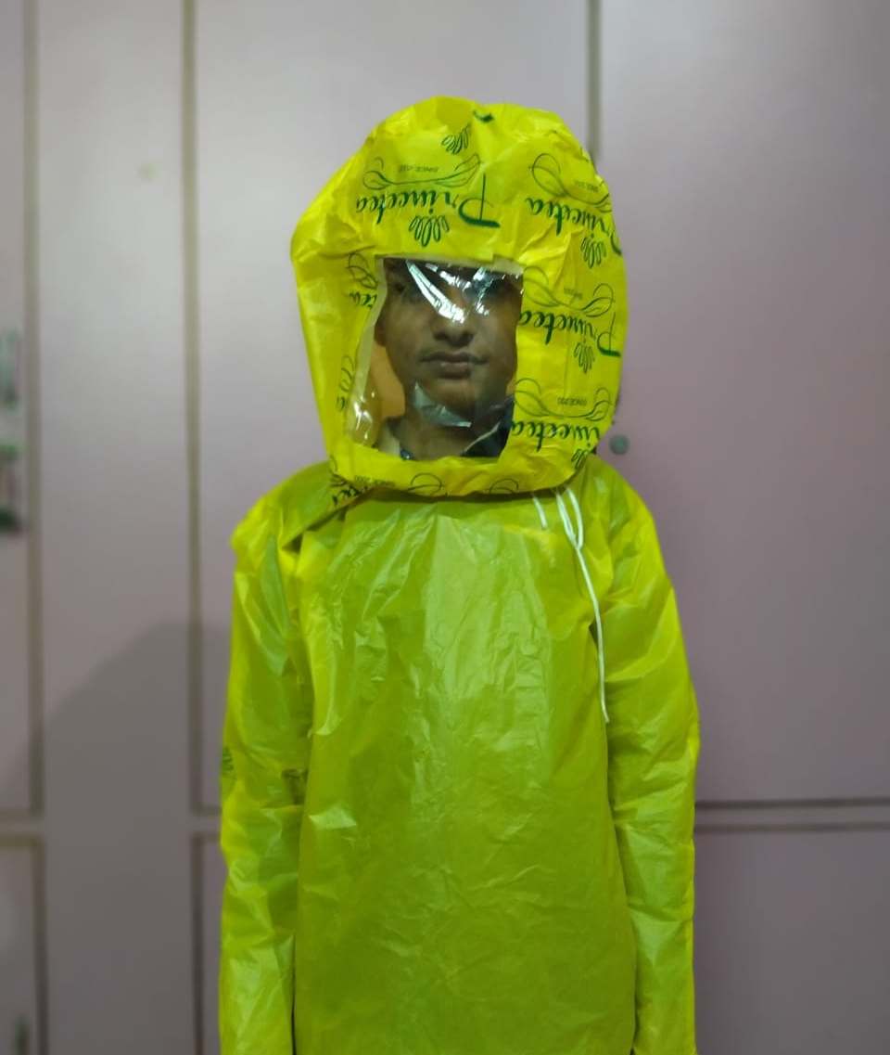
Personal protecting kit using empty polyurethane
VIKAS KUMAR GARG

Slide 8
Paint on pebbles for decoration
SRISHTDEEP KAUR

Slide 9
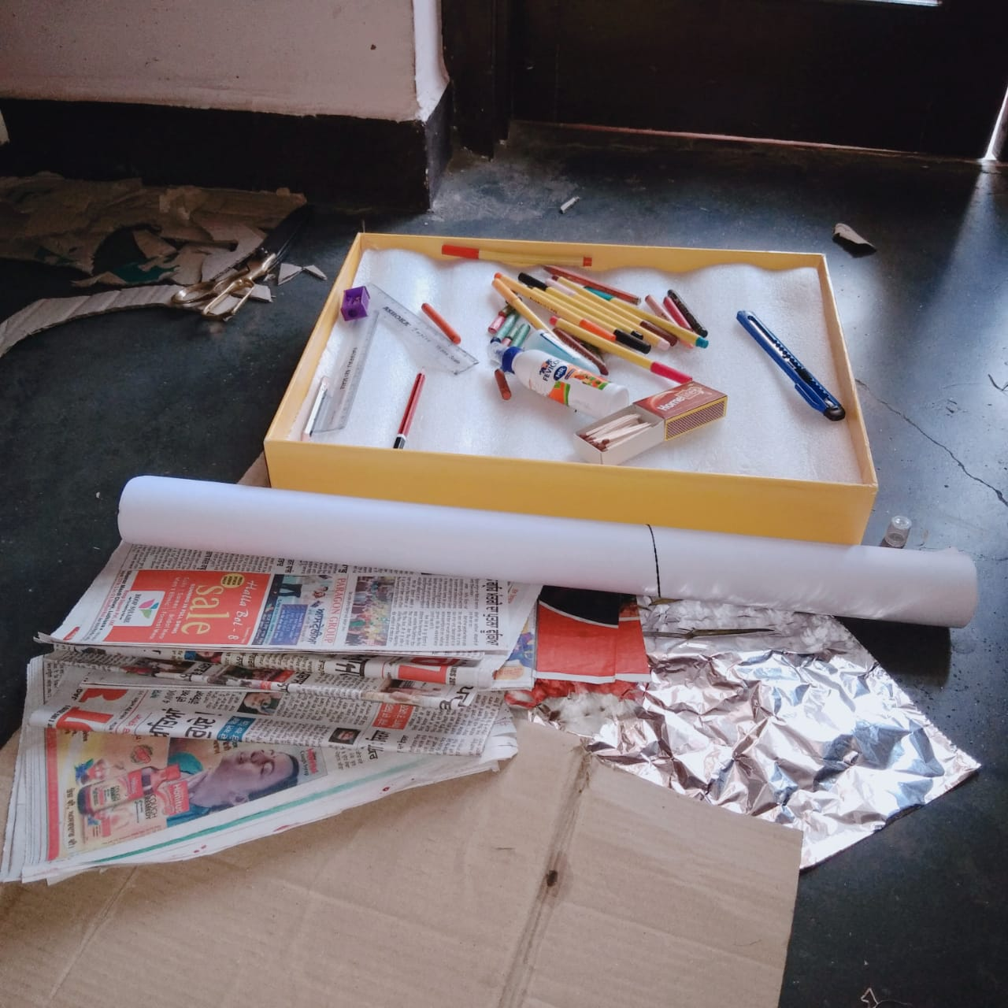
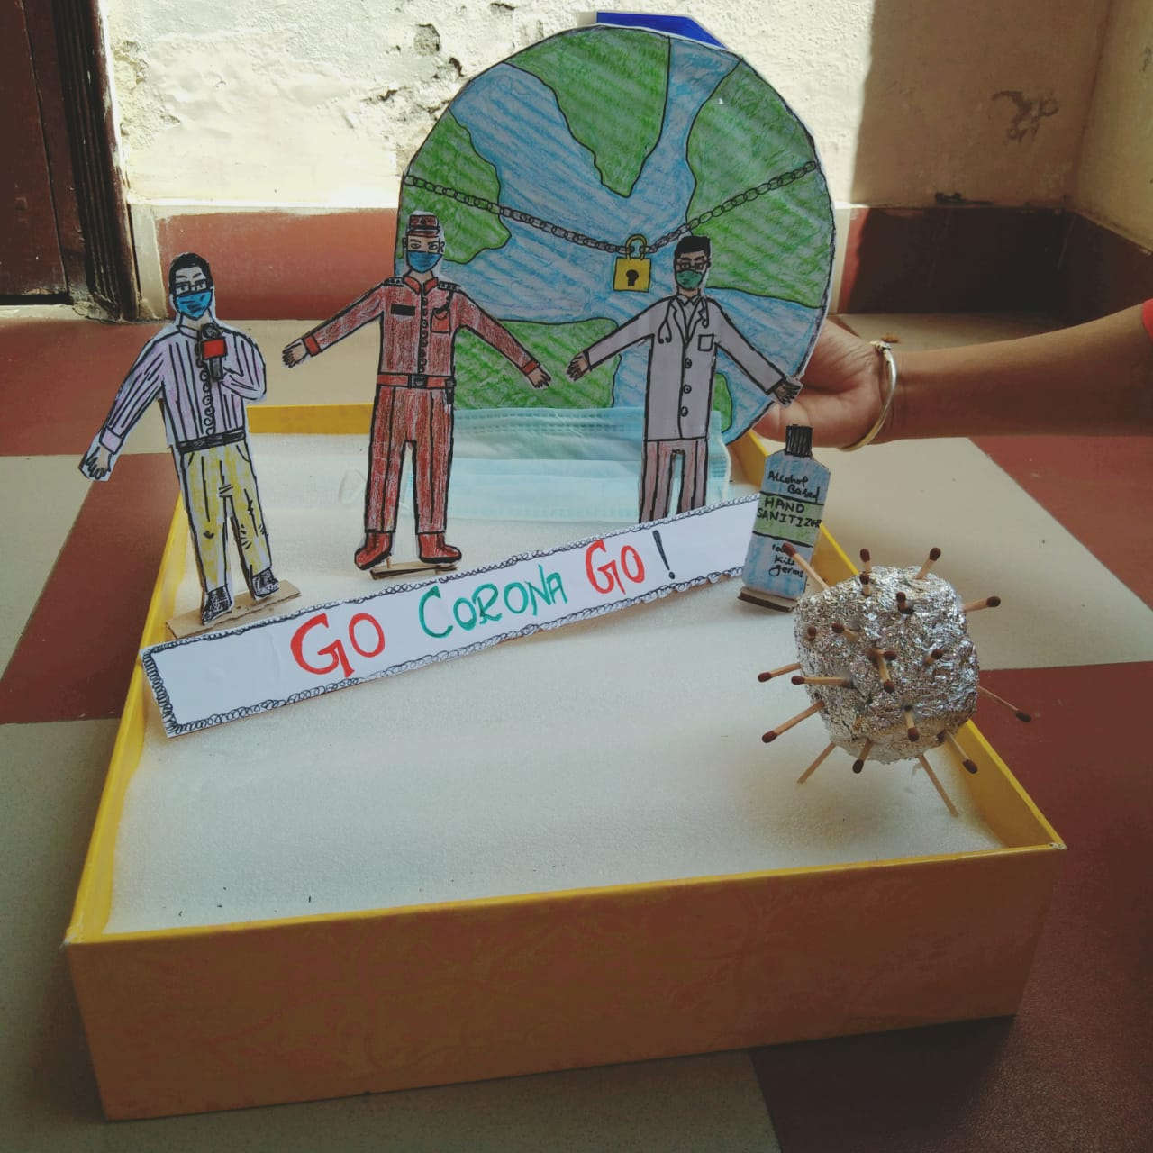
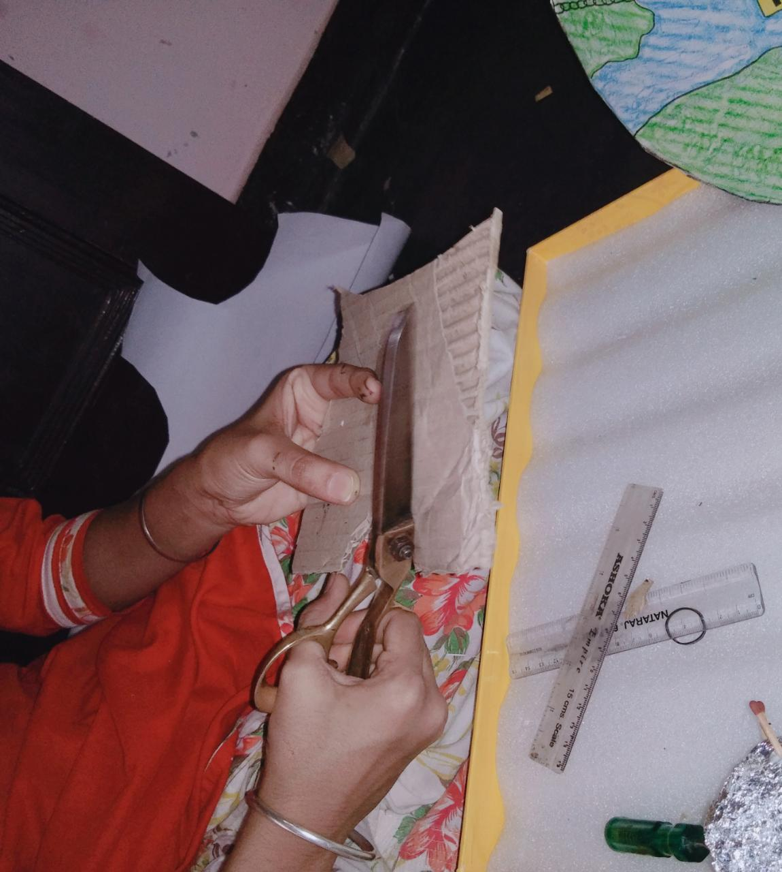
Go Corona Go
NAVTESH KAUR

Slide 10
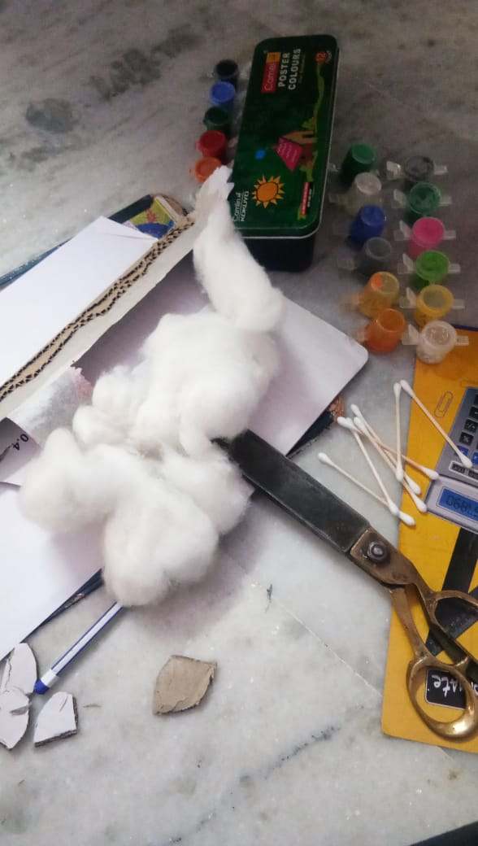
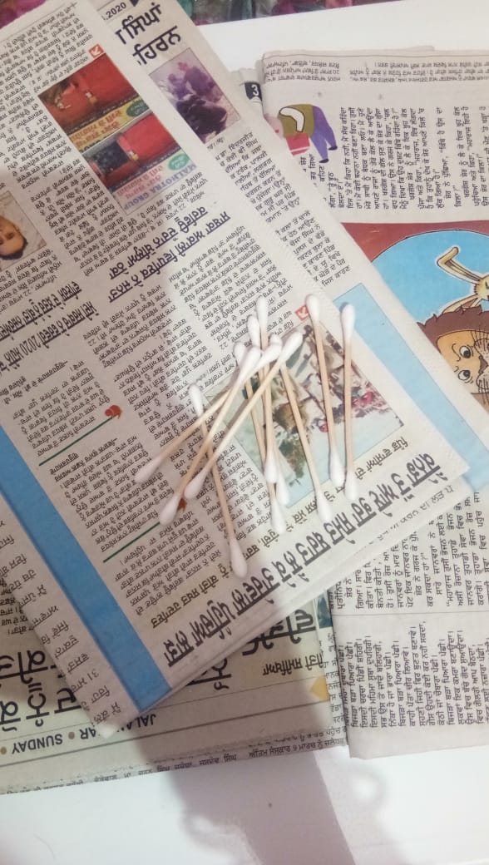
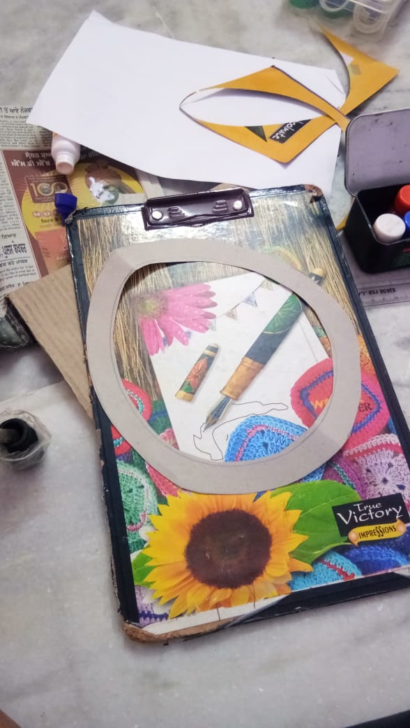
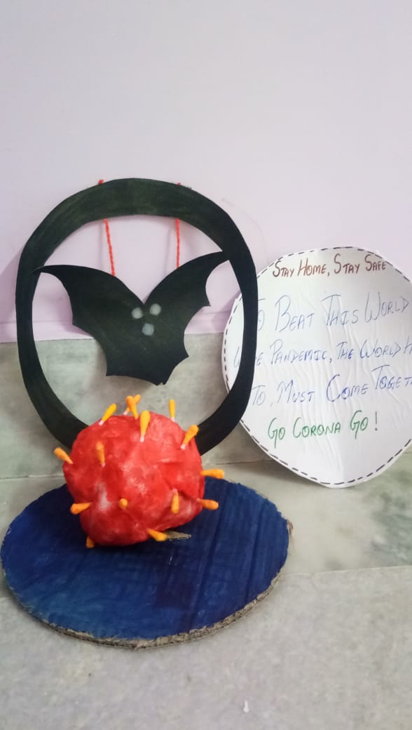
Stay home stay safe
GINNI

Slide 11
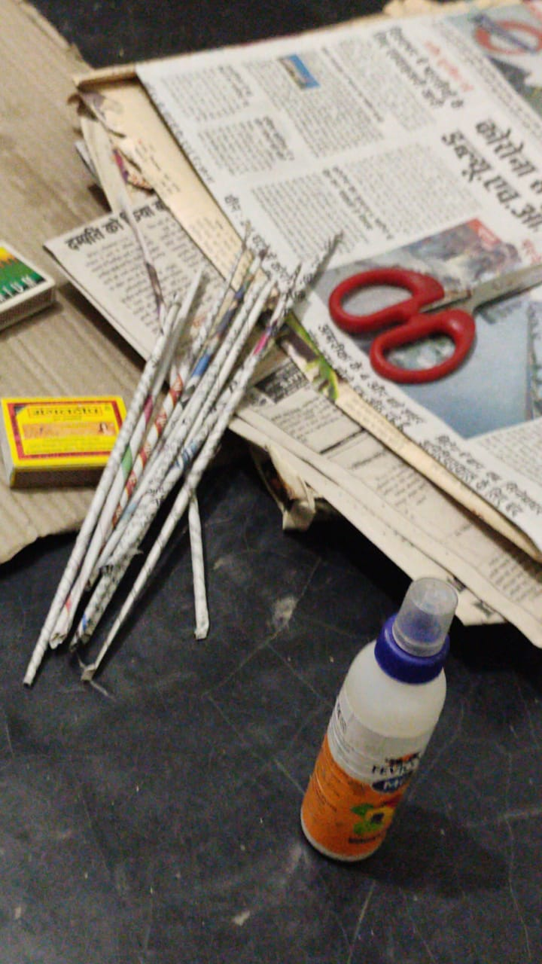
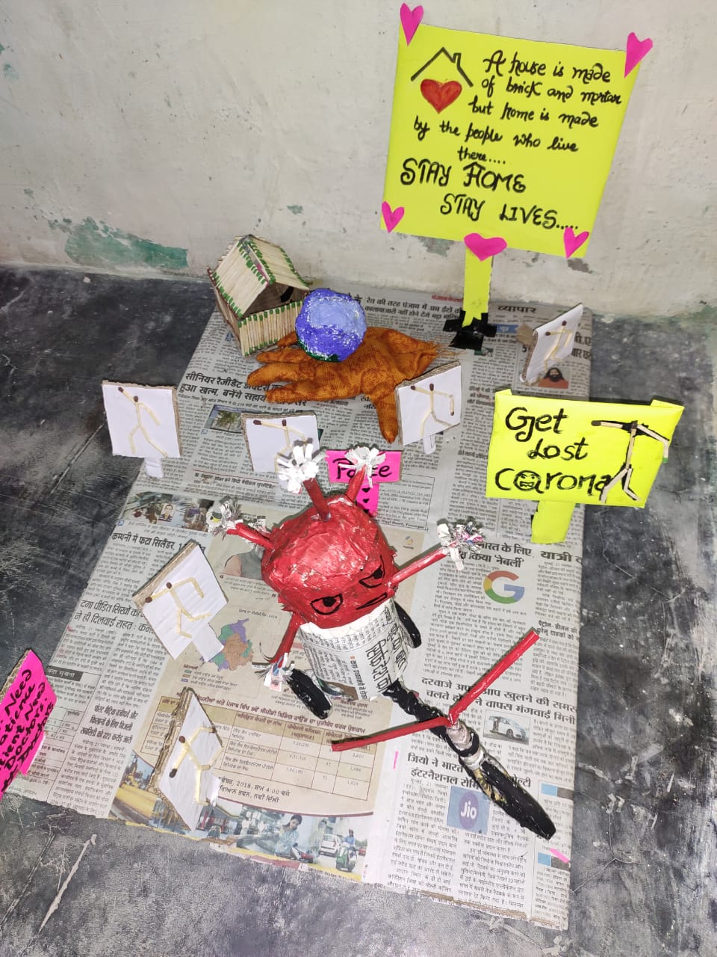
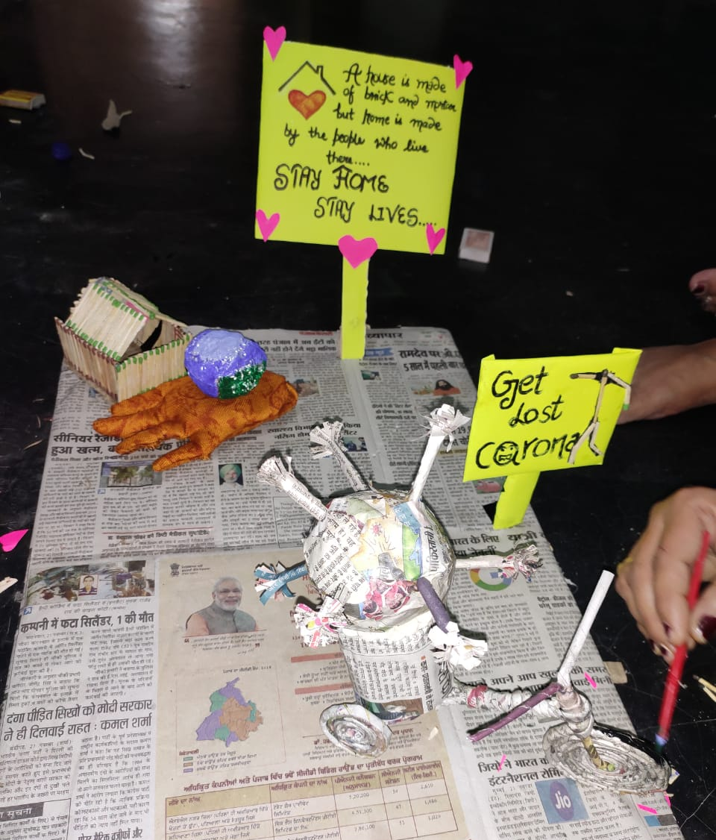
Pratham or davitiya vishav yudh saniko ke baal pe lada gya tha or carona namak yeh triteye vishvyud hi hai jo doctors or police krmviro ke bal parr lada ja raha haii. Salute to our doctors and police.
D-Dearest O-one with C-caring T-Treatment O-on R-right tym..........P-polite O-obident L-Loyal I-Intelligent C-courageous E- Efficient
BHAWNA

Slide 12
Thanks

